Slide 1






















Home
Faculty of Computers and Information Technology (FCIT)
Project Title: Biometric Authentication
“Face Print”
Team Group:
1- Abdulrhman S. Al-shahrani
2- Jehad A. Mahmoud
3- Mohammed H. Al-enizi
4- Mohammed S. Al-enizi
Academic Year: 2022/23

Slide 2

Overview to the project
Overview
Home.
Outline.
Introduction.
Project Objectives.
Related Works.
Methodology.
Analysis.
ERD.
Conclusion.
Questions.

Slide 3
Abstract

Slide 4

Facial recognition technology, commonly referred to as "faceprint" technology, is a biometric technology that uses artificial intelligence algorithms to analyze and identify unique facial features and patterns in digital images or video frames. The technology works by creating a mathematical representation of a person's face, known as a faceprint, and comparing it to other faceprints stored in a database to determine a match.
Abstract
Faceprint technology has been widely adopted in various applications, including security, law enforcement, and customer experience enhancement.

Slide 5
Objectives

Slide 6
Case studies.
Understand how face printing works.
Factors affecting the face print.
Review the advantages of using a face print.
A review of some problems in using the face print.
Try to solve problems.
Project objectives:
Objectives

Slide 7

Related Work

Slide 8
"Faceprint Recognition Accuracy: The Impact of Skin Tone and Facial Hair" (2018) - This study was conducted by researchers from IBM and published in the Proceedings of the IEEE Conference on Computer Vision and Pattern Recognition. It evaluated the impact of skin tone and facial hair on the accuracy of faceprint recognition systems, finding that the recognition accuracy of faceprint systems was lower for individuals with darker skin tones and those with facial hair.
"Investigating the Reliability of Faceprint Authentication for Mobile Devices" (2019) - This study was conducted by researchers from the University of Oxford and published in the Journal of Computer Security. It evaluated the reliability of faceprint authentication for mobile devices, including factors such as lighting conditions, facial expressions, and user demographics. The study found that the accuracy of faceprint authentication was significantly impacted by these factors.
Related Work

Slide 9
"Evaluating the Effectiveness of Faceprint Authentication in Financial Transactions" (2020) - This study was conducted by researchers from the Massachusetts Institute of Technology (MIT) and published in the Journal of Financial Security. It evaluated the effectiveness of faceprint authentication in financial transactions, including factors such as user adoption and security. The study found that faceprint authentication was effective for financial transactions but also highlighted the need for increased security measures to protect sensitive financial data.
"A Study of Faceprint Privacy Concerns and Risks" (2019) - This study was conducted by researchers from the University of California, Berkeley and published in the Journal of Privacy and Confidentiality. It investigated privacy concerns and risks associated with faceprint technology, including issues related to data privacy and security. The study found that the widespread use of faceprint technology raises significant privacy and security concerns and highlights the need for strong privacy and security regulations.
Related Work

Slide 10
How its works?

Slide 11
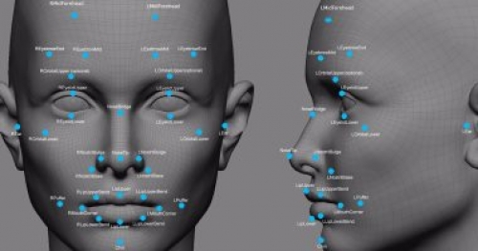
Faceprint technology uses a person's unique facial features, like the heights and depths of their face, to recognize and identify them. It has at least 80 nodal points on a person's face and uses computer algorithms to compare and match these points to confirm the person's identity.
How its Work?
These are the most important points measured by the program:
Nose width.
The distance between the eyes.
The shape of the cheekbones.
The depth of the eye sockets.
Jaw line length.

Slide 12
influencing factors

Slide 13
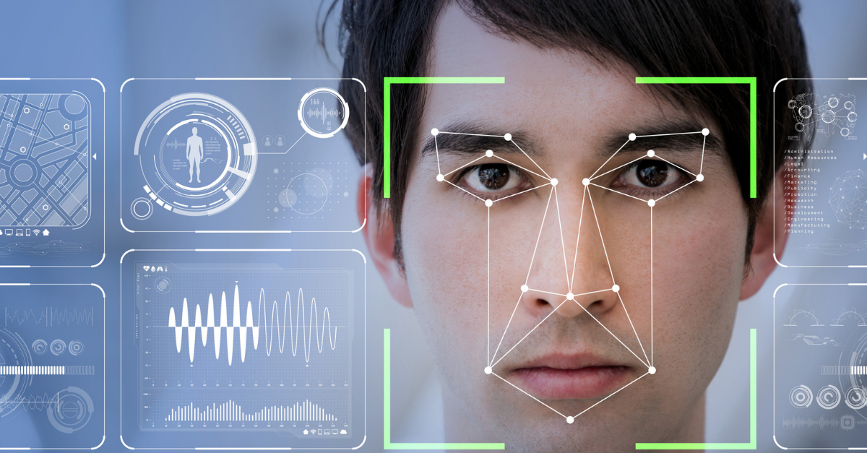
influencing factors
Factors affecting the face print:
Unlike finger prints or DNA, which do not change throughout a person's life, The opposite of facial features that can change according to some factors, including:
Cosmetic surgery.
Age.
Cosmetics.
picture quality.

Slide 14

Pros. & Cons.

Slide 15
Pros of Faceprint Authentication:
Convenience: Faceprint authentication is a fast and easy method of identification, which can make everyday tasks like accessing a smartphone or logging into an online account more convenient.
Security: Faceprint authentication provides a high level of security because it is based on unique physical features that cannot be easily duplicated.
Speed: Faceprint authentication is often faster than other biometric authentication methods like fingerprint or iris scanning.
Non-intrusive: Unlike other biometric methods like DNA or fingerprint scanning, faceprint authentication does not require physical contact with a device, making it a more non-intrusive form of identification.
Pros.

Slide 16
Cons of Faceprint Authentication:
Privacy Concerns: The use of faceprint authentication raises privacy concerns, particularly with regards to the storage and use of sensitive personal data.
False Positives and False Negatives: Faceprint authentication is not 100% accurate and can result in false positives, where the system identifies the wrong person, or false negatives, where the system fails to identify the right person.
Technical Challenges: Faceprint authentication is a complex technology that requires sophisticated algorithms and hardware, which can result in technical challenges and system failures.
Bias: Faceprint authentication algorithms can be biased and result in discriminatory outcomes, particularly for people with different facial structures or skin tones.
Cost: Implementing faceprint authentication can be expensive, both in terms of hardware and software costs, as well as the cost of training and maintaining the system.
Cons.

Slide 17
How to Solve these Cons.?

Slide 18
To address the cons of faceprint authentication:
For privacy concerns, companies can implement strong privacy policies and security measures and be transparent about personal data collection, use and storage.
To reduce false positives and false negatives, companies can improve and update their algorithms and use multiple forms of biometric authentication.
To address technical challenges, companies can invest in quality hardware and software and conduct regular maintenance.
To address bias, companies can regularly test and evaluate their algorithms, incorporate diverse data sets and seek input from underrepresented groups.
To address cost, companies can use existing hardware/software systems, seek funding and partnerships, or use open-source technologies.
Solutions

Slide 19
Thank You
Any Questions?
Questions?

